Slide 1
OENCODERAUTOENCODERAUTOE
2020 Jan 8th
Wed 4.pm
Basics and Extensions of Autoencoder
KwangWoon University
Machine Learning Study
TEAM A

Slide 2








AUTOENCODER
Unsupervised
Learning
Reconstructor
$$x_{1}$$
$${x′}_{1}$$
$$x_{2}$$
$${x′}_{2}$$
Dimension
Reduction
Encoder
Decoder
Base
$$x_{3}$$
$${x′}_{3}$$
$$x_{4}$$
$${x′}_{4}$$
Basic structure of Autoencoder
Key Concepts of Autoencoder

Slide 3
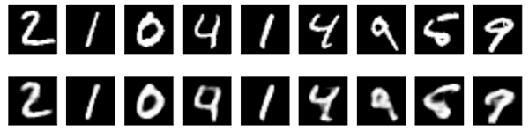








AUTOENCODER
Encoder
Decoder
$$x_{1}$$
$${x′}_{1}$$
Only the key features of the input data entered to Hidden layer by the learning process, and the rest of the information (Non-feature) is being loss
Reconstruction input data by approximate value from input, this data based on what has been learned in the Hidden layer
$$x_{2}$$
$${x′}_{2}$$
$$x_{3}$$
$${x′}_{3}$$
$$x_{4}$$
$${x′}_{4}$$

Slide 4
AUTOENCODER
Encoder
Decoder
$$x_{1}$$
$${x′}_{1}$$
Only the key features of the input data entered to Hidden layer by the learning process, and the rest of the information (Non-feature) is being loss
Reconstruction input data by approximate value from input, this data based on what has been learned in the Hidden layer
$$x_{2}$$
$${x′}_{2}$$
$$x_{3}$$
$${x′}_{3}$$
$$x_{4}$$
$${x′}_{4}$$

Slide 5



AUTOENCODER
Encoder
Decoder
$$x_{1}$$
$${x′}_{1}$$
Only the key features of the input data entered to Hidden layer by the learning process, and the rest of the information (Non-feature) is being loss
Reconstruction input data by approximate value from input, this data based on what has been learned in the Hidden layer
$$y_{1}$$
$$x_{2}$$
$${x′}_{2}$$
$$y_{2}$$
$$x_{3}$$
$${x′}_{3}$$
$$y_{3}$$
$$x_{4}$$
$${x′}_{4}$$
The key of the Autoencoder is let the model Reconstruction same output based on input, so that the feature can be extracted at the hidden layer
(i.e., find the weight that makes the input value and the output value as similar as possible).

Slide 6
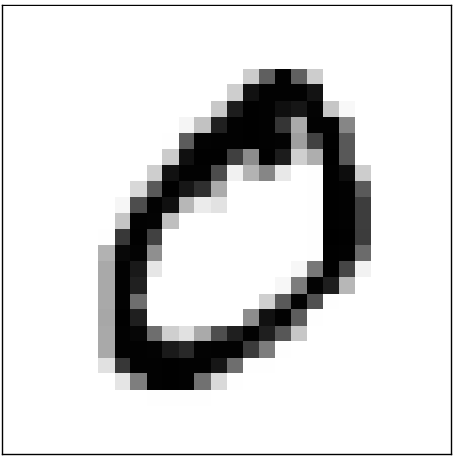










ENCODER
- Feature Extracting by dimension reduction
$$x_{1}$$
$$x_{1}$$
$$y_{1}$$
$$y_{1}$$
: Input Data
: Hidden Layer Node
$$x_{2}$$
Encoder
$$y_{2}$$
$$x_{3}$$
Only the key features of the input data entered to Hidden layer by the learning process, and the rest of the information (Non-feature) is being loss
$$y_{3}$$
$$x_{4}$$
Input Data
Feature
(Weight)
$$φ :X →F$$
Extracts key information from data through dimension reduction
These Features will be uses for reconstructing input

Slide 7











DECODER
- Reconstruction from Feature
$${x′}_{1}$$
$$y_{1}$$
$$x_{1}$$
$$y_{1}$$
: Hidden Layer Node
: Output Data
$${x′}_{2}$$
Decoder
$$y_{2}$$
$${x′}_{3}$$
Reconstruction input data by approximate value from input, this data based on what has been learned in the Hidden layer
$$y_{3}$$
$${x′}_{4}$$
Feature
Output Data
(Weight)
$$ψ :F→X$$
Reconstruction input data from its Feature
Similarity of input and output data represent models performance

Slide 8
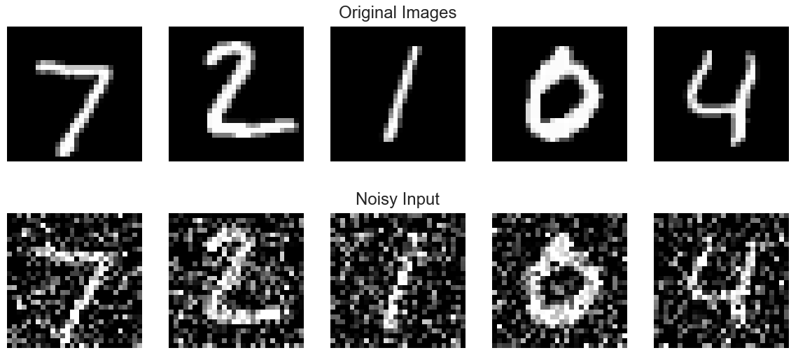
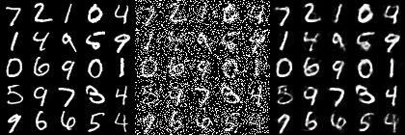













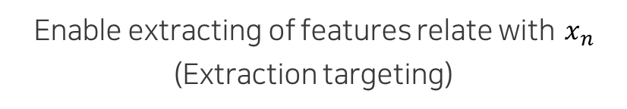




Denoising Autoencoder
$$x_{1}$$
$${x′}_{1}$$
Training
$$\hat{x}$$
$$y_{n}$$
$${x′}_{n}$$
$$x_{n}$$
$$x_{2}$$
$${x′}_{2}$$
Update $y_{n}$ let $\hat{x}$ be $x_{n}$
$$x_{3}$$
$${x′}_{3}$$
Enable extracting of features relate with $x_{n}$
(Extraction targeting)
$$x_{4}$$
$${x′}_{4}$$
$$\hat{x}=x+r$$
$$x$$
$r$ = Random Noise
$x$ = Original Image

Slide 9






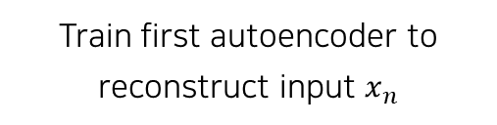





Stacked Autoencoder
Training
$$x_{1}$$
$${x′}_{1}$$
$$y_{1}$$
Train first autoencoder to reconstruct input $x_{n}$
$$x_{2}$$
$${x′}_{2}$$
$$y_{2}$$
$$x_{3}$$
$${x′}_{3}$$
$$y_{3}$$
$$x_{4}$$
$${x′}_{4}$$
Notes:
Stacked autoencoder를 훈련할 때에는 한 번에 전체 autoencoder를 학습하는 시키는 것보다, 한번에 하나의 simple autoencoder를 학습하고 이를 계속 쌓아 올려가는 방식이 더 빠르다.
우선 입력 값 x를 target으로 하는 첫 번째 autoencoder를 훈련시킨다.

Slide 10


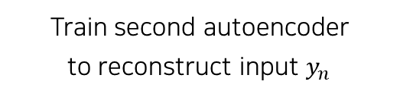



Stacked Autoencoder
Training
$$y_{1}$$
$${y′}_{1}$$
Train first autoencoder to reconstruct input $x_{n}$
$$z_{1}$$
$$y_{2}$$
$${y′}_{2}$$
Train second autoencoder
to reconstruct input $y_{n}$
$$z_{2}$$
$$y_{3}$$
$${y′}_{3}$$
Notes:
두 번째 autoencoder는 첫 번째 autoencoder의 hidden layer를 재구성하도록 학습시킨다. 즉 y를 input으로 하는 autoencoder를 훈련시킨다.
만약 더 깊은 autoencoder를 학습하고 싶다면, 이와 같이 이전 autoencoder의 hidden layer를 입력으로 받는 autoencoder를 개별적으로 학습시킨다.

Slide 11




Stacked Autoencoder
Training
$$x_{1}$$
$${x′}_{1}$$
Build stacked autoencoder
by stacking autoencoders
trained in the previous step
$$y_{1}$$
$${y′}_{1}$$
$$x_{2}$$
$$z_{1}$$
$${x′}_{2}$$
$$y_{2}$$
$${y′}_{2}$$
$$x_{3}$$
$$z_{2}$$
$${x′}_{3}$$
$$y_{3}$$
$${y′}_{3}$$
$$x_{4}$$
$${x′}_{4}$$
Notes:
마지막으로, 이전 단계에서 훈련시킨 autoencoder들을 다음과 같이 쌓아 올려 stacked autoencoder를 만든다.

Slide 12
















Stacked Autoencoder
Unsupervised pre-training
by using stacked autoencoder
$$x_{1}$$
$${x′}_{1}$$
$$y_{1}$$
$${y′}_{1}$$
Train stacked autoencoder
by using the total data set
Total
Data
$$x_{2}$$
$$z_{1}$$
$${x′}_{2}$$
$$y_{2}$$
$${y′}_{2}$$
$$x_{3}$$
$$z_{2}$$
$${x′}_{3}$$
$$y_{3}$$
$${y′}_{3}$$
$$x_{4}$$
$${x′}_{4}$$
Notes:
Stacked autoencoder를 이용하면 일부만 레이블이 있고 대부분이 레이블이 없는 데이터로 이루어진 데이터 셋을 분류하여 비지도 사전학습을 할 수 있다.
먼저 전체 데이터를 사용하여 stacked autoencoder를 학습시킨다.

Slide 13

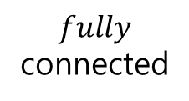









Stacked Autoencoder
Unsupervised pre-training
by using stacked autoencoder
$$x_{1}$$
$$fully$$
connected
Copy the parameters of layers from input layer to center layer in the autoencoder.
Then, stack the softmax layer
in the top layer, and fully-connect the top two layers.
$$y_{1}$$
$$x_{2}$$
$$z_{1}$$
$$y_{2}$$
$$x_{3}$$
$$z_{2}$$
$$y_{3}$$
$$x_{4}$$
$$softmax$$
Notes:
Stacked autoencoder를 이용하면 일부만 레이블이 있고 대부분이 레이블이 없는 데이터로 이루어진 데이터 셋을 분류하여 비지도 사전학습을 할 수 있다.
먼저 전체 데이터를 사용하여 stacked autoencoder를 학습시킨다. 그 후, 그림과 같이 stacked autoencoder의 정 중앙 layer 아래에 존재하는 층들을 복사해온다. 그 다음 softmax layer를 최상위 층에 쌓고, 최상위 2개의 layer를 전연결 한다.

Slide 14
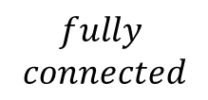
Stacked Autoencoder
Unsupervised pre-training
by using stacked autoencoder
$$x_{1}$$
$$fully$$
$$connected$$
$$y_{1}$$
Train the network by using labeled data.
Finally, the network will operate
as a classifier
Backpropagation algorithm
⇒ Cross Entropy loss
Labeled
Data
$$x_{2}$$
$$z_{1}$$
$$y_{2}$$
$$x_{3}$$
$$z_{2}$$
$$y_{3}$$
$$x_{4}$$
$$softmax$$
Notes:
마지막으로 Label이 있는 데이터를 이용하여 해당 네트워크가 classifier로 동작하도록 학습시킨다. Backpropagation algorithm은 cross entropy loss 방식을 사용한다.
이와 같은 과정들을 통해 레이블이 없는 데이터에 레이블을 부여해주는 classifier를 만들어, 비지도 사전학습을 할 수 있다.

Slide 15
Autoencoder As Generator
Autoencoder Model also can be working as a Generator based on its Reconstruction concept
Variational Autoencoder

Slide 16
Autoencoder As Generator
Autoencoder Model also can be working as a Generator based on its Reconstruction concept
Variational Method
When the problem of finding the extreme point of function p(x),
if it hard to solve by directly access that function(p(x))
Optimize function by replacing it with another easy-to-handle function q(x)
This way we can get an approximate year for p(x)

Slide 17








Variational Autoencoder
$$x_{1}$$
$${x′}_{1}$$
If we can get a low-level representation z from high-level data X
$$x_{2}$$
$${x′}_{2}$$
We can Adjust Z to create new images that are not given in the training set
$$x_{3}$$
$${x′}_{3}$$
Key is…
$$x_{4}$$
$${x′}_{4}$$
How can we high-level data be expressed as
low-level data?

Slide 18
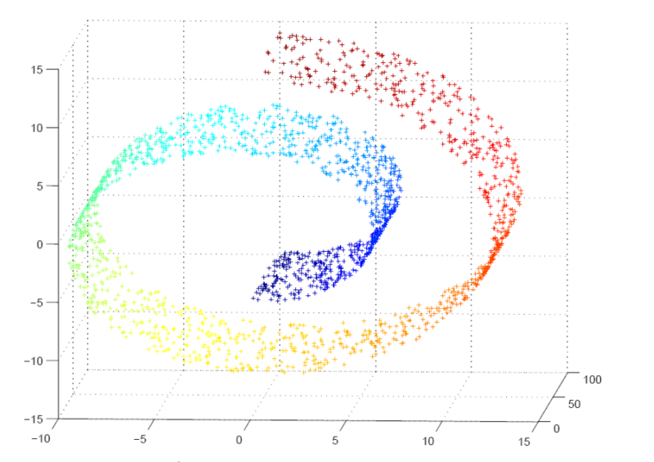
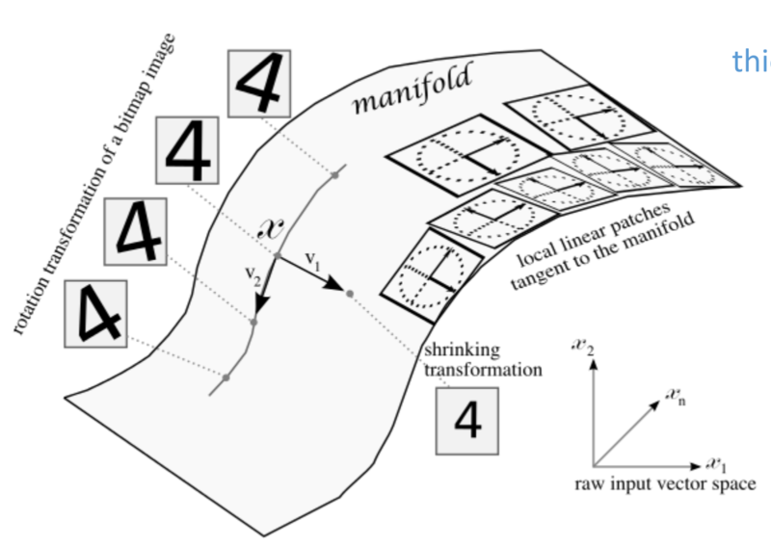
Variational Autoencoder
$$x_{1}$$
$${x′}_{1}$$
Key is…
How can we high-level data be expressed as
low-level data?
$$x_{2}$$
$${x′}_{2}$$
$$x_{3}$$
$${x′}_{3}$$
$$x_{4}$$
$${x′}_{4}$$

Slide 19
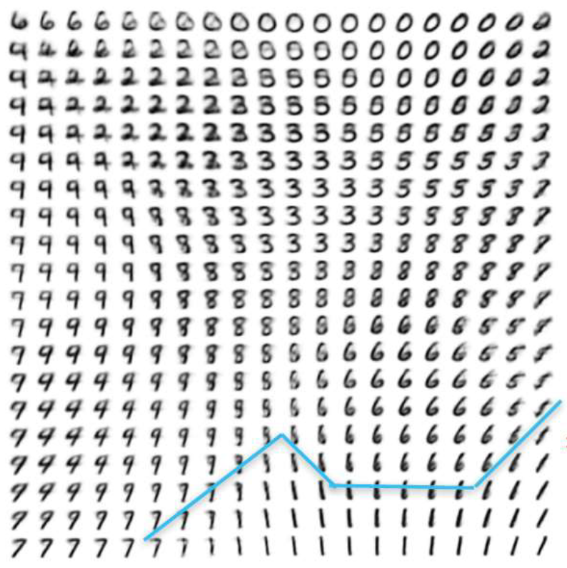
Variational Autoencoder
$$x_{1}$$
$${x′}_{1}$$
Key is…
How can we high-level data be expressed as
low-level data?
$$x_{2}$$
$${x′}_{2}$$
$$x_{3}$$
$${x′}_{3}$$
$$x_{4}$$
$${x′}_{4}$$

Slide 20
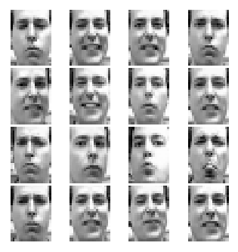







Variational Autoencoder
$$x_{1}$$
$$x_{1}$$
Example of Latent variable
$$x_{n} :$$
Input Image
Type : Cam Axis : Light
$$y_{n}$$
( Smile : [14,0,-3] : White )
$$y_{1}$$
$$y_{1}$$
$$y_{n} :$$
Latent variable
Generate
Recognition
In VAE, Latent variables are assumed to be normal distribution
$$x_{n}$$
It is easier to update optimized value.

Slide 21











Variational Autoencoder
$$x_{1}$$
$${x′}_{1}$$
$$x_{2}$$
$$μ$$
$${x′}_{2}$$
$$y$$
$$x_{3}$$
$$Σ$$
$${x′}_{3}$$
$$x_{4}$$
$${x′}_{4}$$
Encoder
Latent variable
Decoder

Slide 22
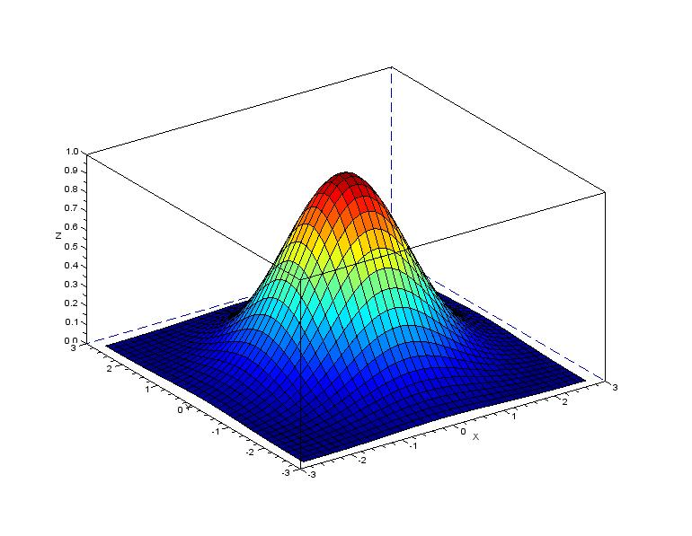
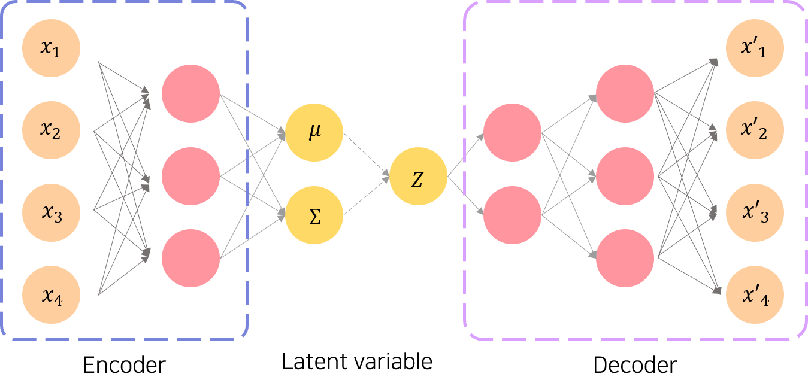







Variational Autoencoder
Generate
Latent
Space
Generate
Image
Based on
Latent Space
Generated
Image
Based on
Latent Space
$$q_{φ}(Z|X^{(i)})$$
$$P_{θ}(X^{(i)}|Z)$$
Generate a distribution of Latent variables
Generate similar output
$$x$$
$$y$$
$$x$$
$$or Z$$
Approximate $x$

Slide 23


Variational Autoencoder
Generate
Latent
Space
Generate
Image
Based on
Latent Space
Generated
Image
Based on
Latent Space
$$q_{φ}(Z|X^{(i)})$$
$$P_{θ}(X^{(i)}|Z)$$
Generate a distribution of Latent variables
Generate similar output
HOW TO OPTIMIZE IT?

Slide 24
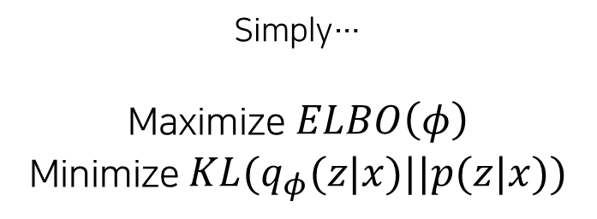
Variational Autoencoder
Generate
Latent
Space
Generate
Image
Based on
Latent Space
Generated
Image
Based on
Latent Space
$$q_{φ}(Z|X^{(i)})$$
$$P_{θ}(X^{(i)}|Z)$$
Generate a distribution of Latent variables
Generate similar output
Simply…
Maximize $ELBO\left(φ\right)$
Minimize $KL(q_{φ}(z|x)||p(z|x))$

Slide 25

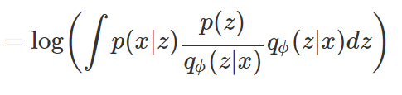




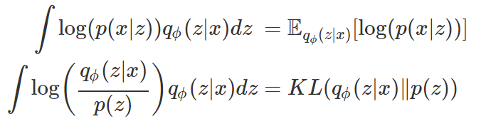

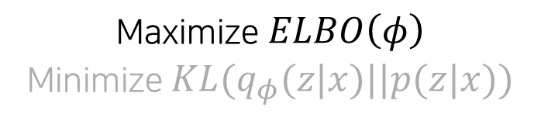

Variational Autoencoder
Maximize $ELBO\left(φ\right)$
Minimize $KL(q_{φ}(z|x)||p(z|x))$
Maximize the ELBO and approximate it to q(x) as p(x)
<Variational Method>
$$Find argmax ELBO(φ)$$

Slide 26
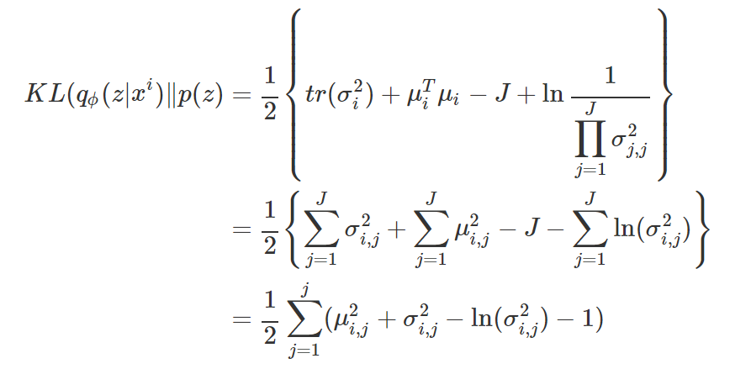

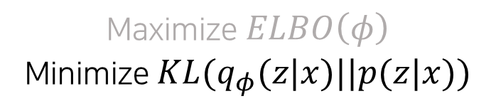
Variational Autoencoder
Maximize $ELBO\left(φ\right)$
Minimize $KL(q_{φ}(z|x)||p(z|x))$
<Loss function from ELBO method>
Multivariate
Kullback-Leibler Divergence

Slide 27
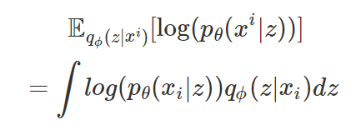


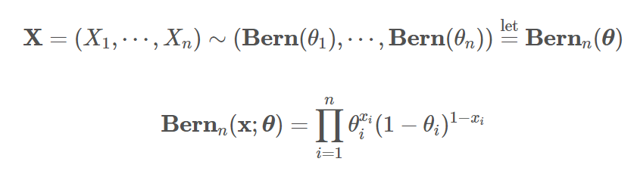

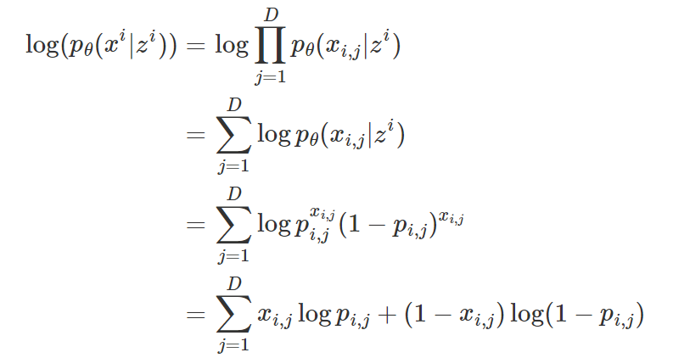
Variational Autoencoder
Expectation
Multivariable Bernoulli Distribution

Slide 28
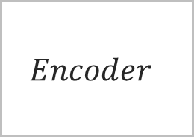
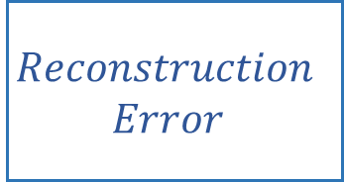
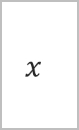
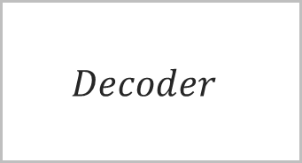
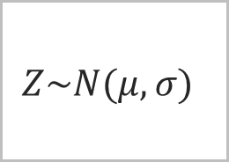
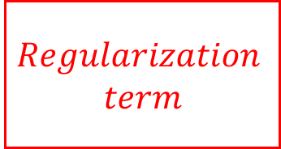
Variational Autoencoder
Training Process
$$x$$
$$Encoder$$
$$Regularization$$
$$term$$
Optimize
Sampling
$$Z\sim N(μ,σ)$$
$$Decoder$$
$$Reconstruction$$
$$Error$$

Slide 29
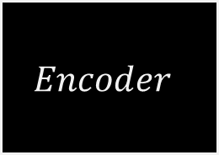


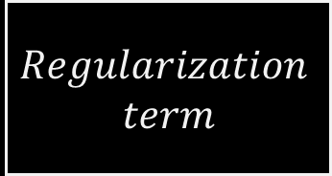
Variational Autoencoder
Generate Process
$$x$$
$$Encoder$$
$$Regularization$$
$$term$$
Sampling
$$Z\sim N(μ,σ)$$
$$Decoder$$
$$x$$
Z as input
Generate Image

Slide 30

Variational Autoencoder
$$x$$
Generate Image
Generate images that correspond to latent space

